Slide 1
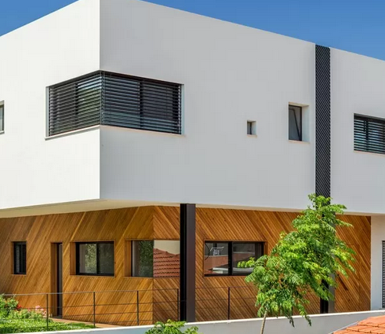
Data Science Project Future House Pricing Prediction
By: Yuval Berkovich & Nitay Hen

Slide 2
Introduction
In this project, we will take a look at Real Estate deals from 2010 to 2020, see the gradual increase in pricing among several cities in Gush Dan, and analyze the data individually for each city with the help of several factors.
More Importantly, we will try and see if we can predict the house pricing in the foreseeable future based on those past statistics, using machine learning algorithms.

Slide 3
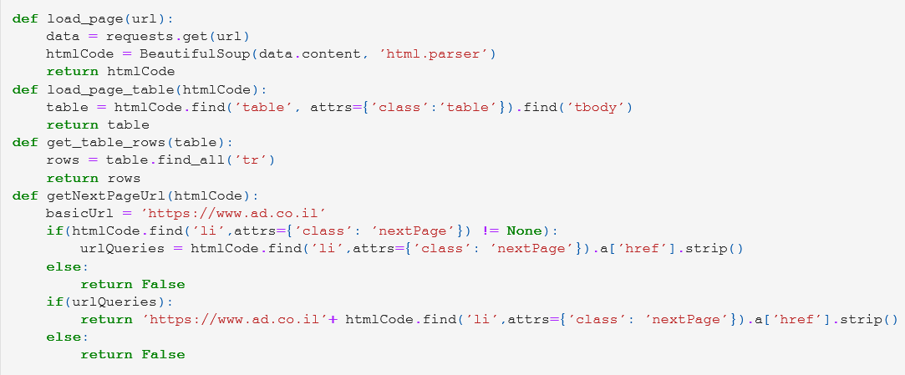
Crawling Procedure
Load the page
Functions:
Load the page table
Get all rows from the table
Get the next page URL

Slide 4
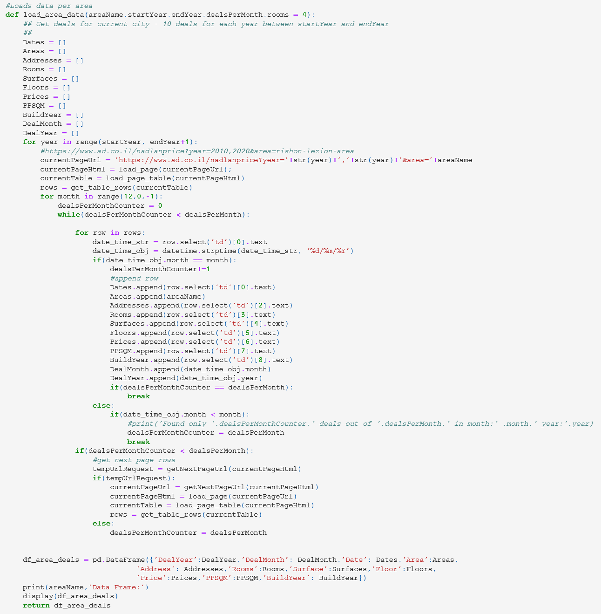
Crawling Procedure
Loading data into Data Frame for each area:

Slide 5
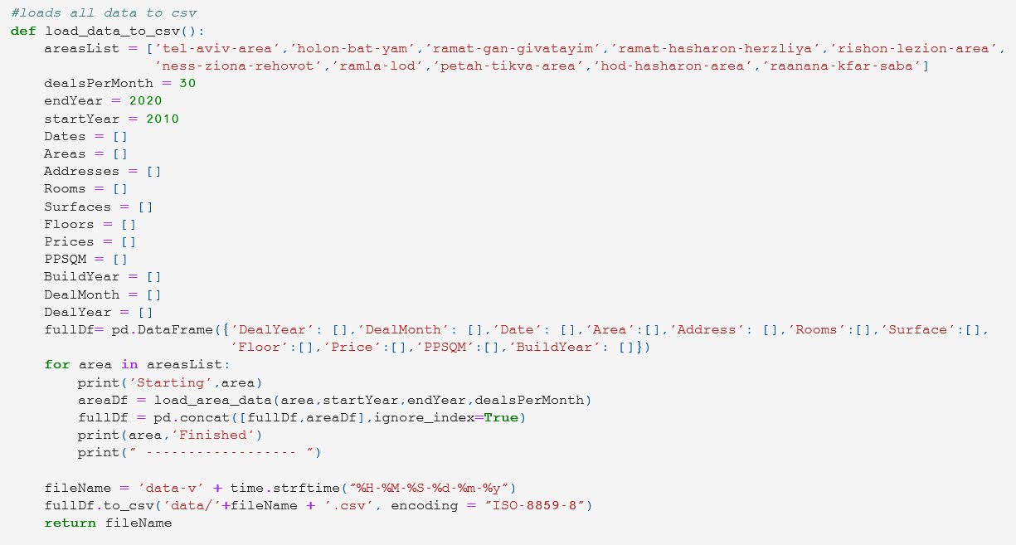
Crawling Procedure
Loading the data to CSV:

Slide 6
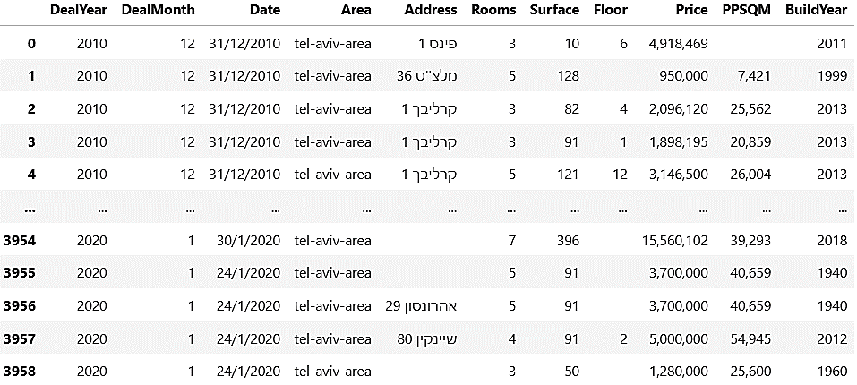
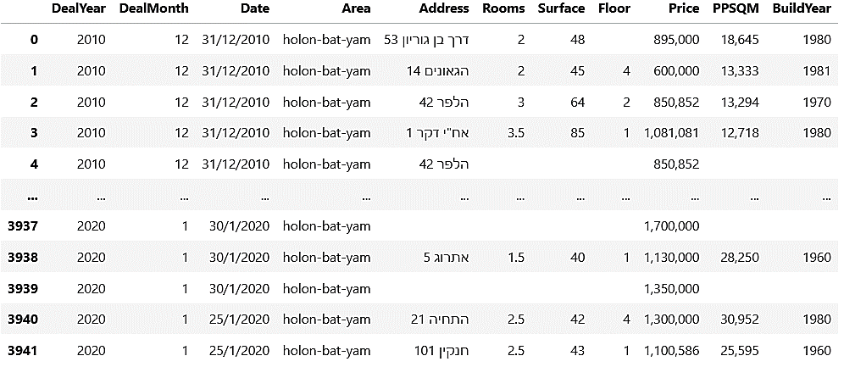
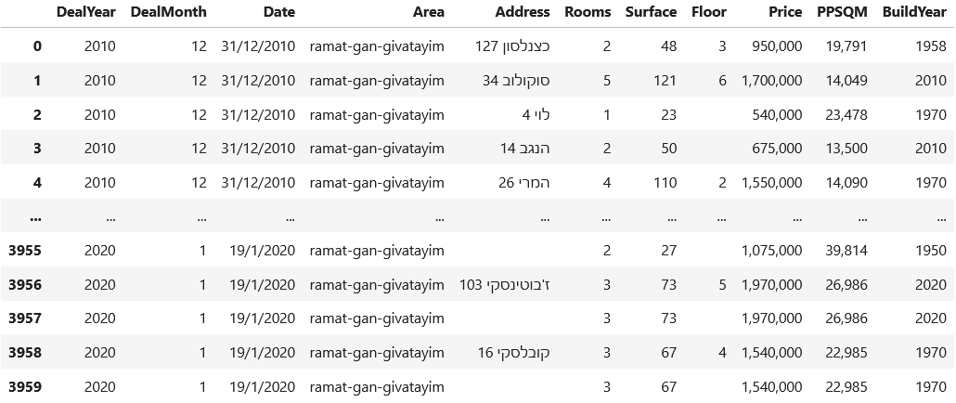
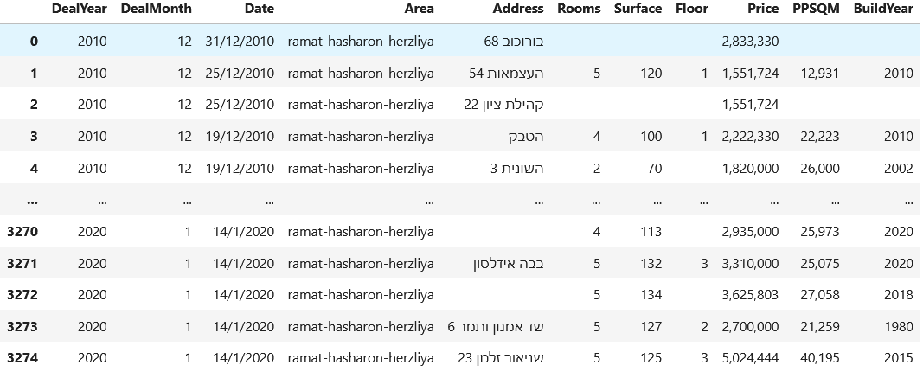
Data Frames divided to areas: * Notes: - Floors without value are houses, not apartments. - Addresses without values are still legitimate for data analysis. - Up to 30 deals per month in each area represented.
Tel Aviv:
Holon & Bat-Yam:
Ramat-Gan & Givatayim:
Herzliya & Ramat-Ha’Sharon:

Slide 7
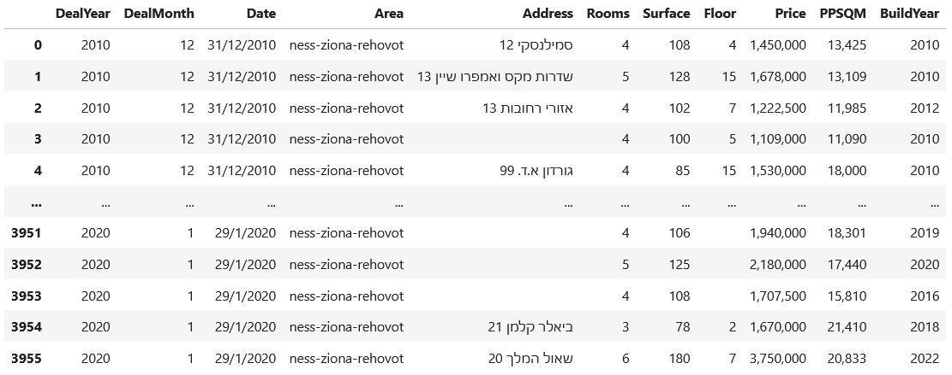
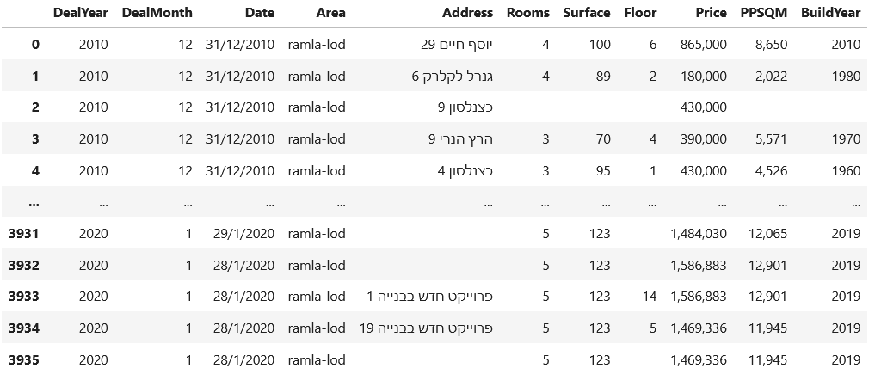
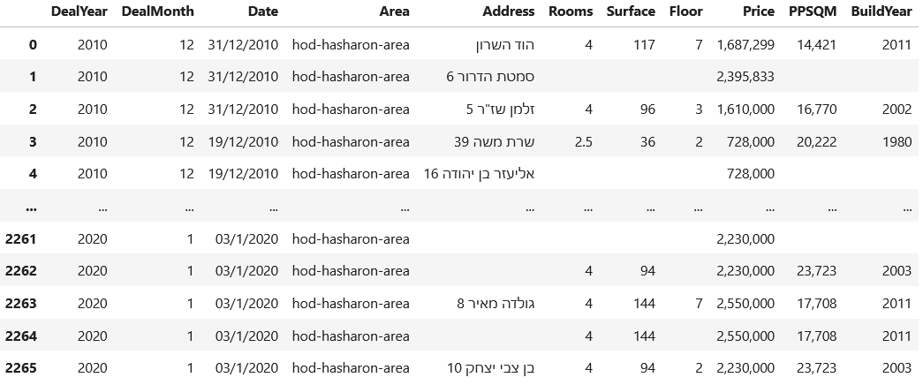
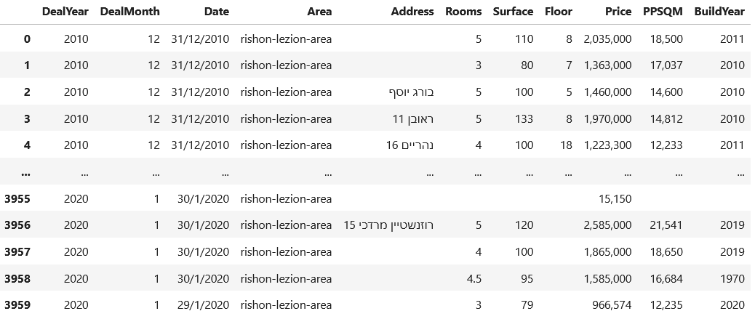
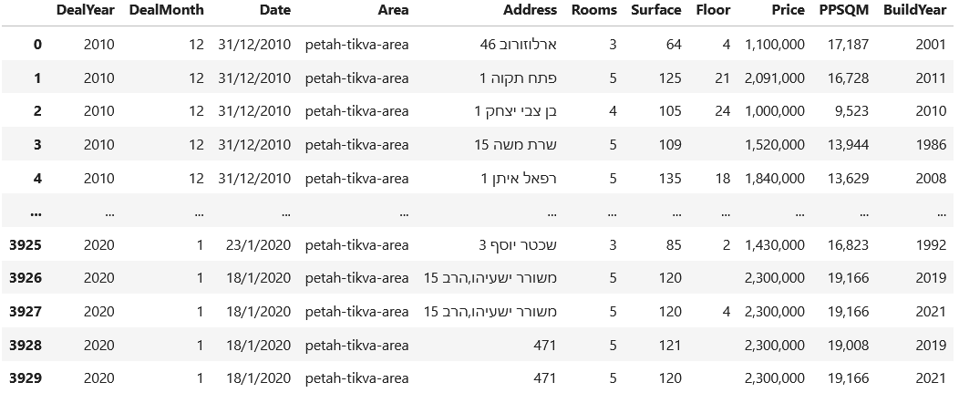
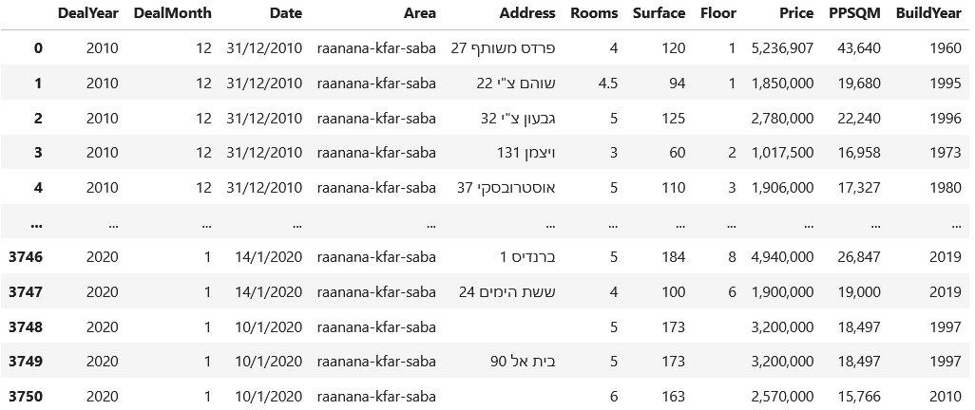
Data Frames divided to areas: * Notes: - Floors without value are houses, not apartments. - Addresses without values are still legitimate for data analysis. - Up to 30 deals per month in each area represented.
Rishon Le’Zion:
Ramla & Lod:
Hod Ha’Sharon:
Ness-Ziona & Rehovot:
Petah-Tikva:
Raanana & Kfar-Saba:

Slide 8
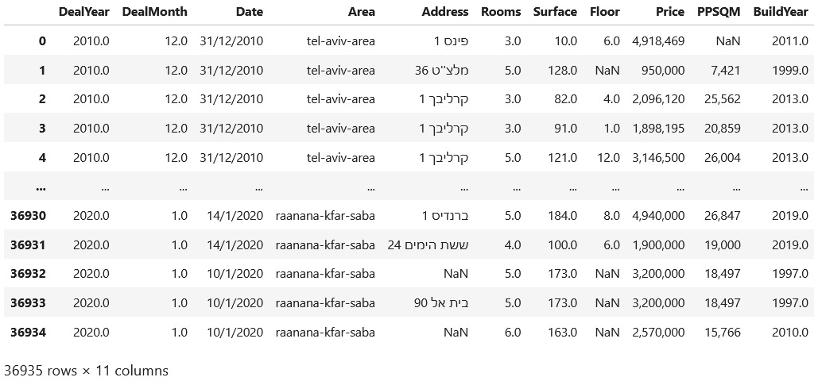
Crawling Procedure
The Complete Data Frame of Gush Dan:
* 406,285 kb of data extracted from ad.co.il

Slide 9
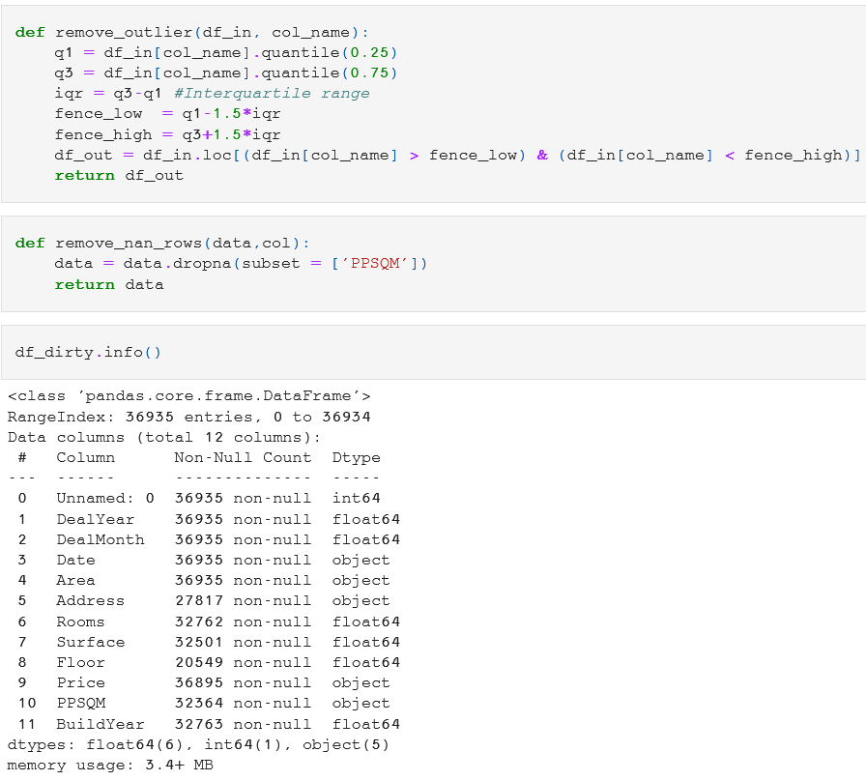
Data Cleaning
Removal of outliers &
Remove NaN Functions:
Function to eliminate
abrupt values
(Upper & Bottom quantiles)
Removal of rows
with PPSQM as NULL.
Representation of the
amount of data in each
column (Dirty DF).

Slide 10
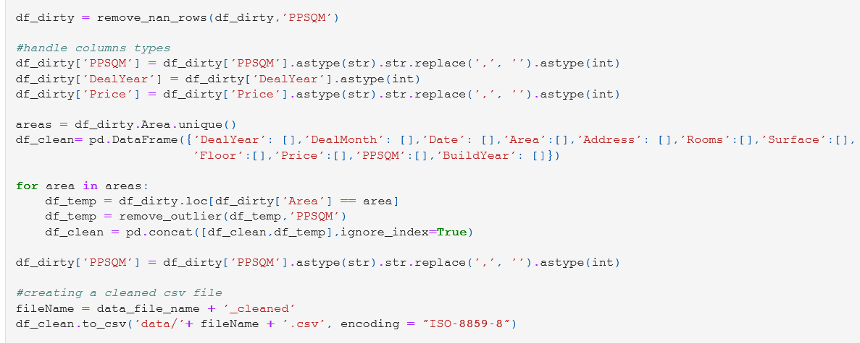
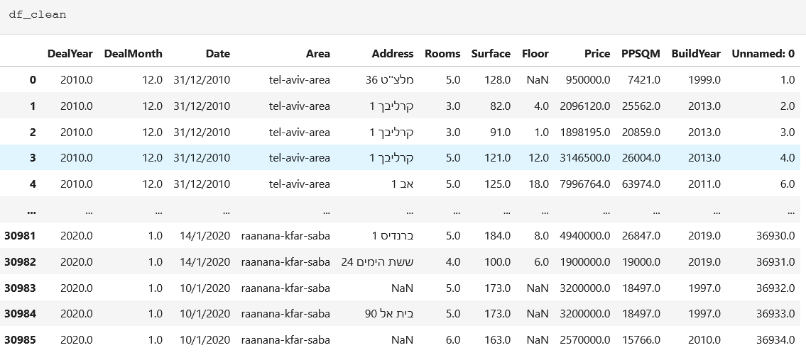
Clean Data Frame
5,949 rows have
been removed.

Slide 11
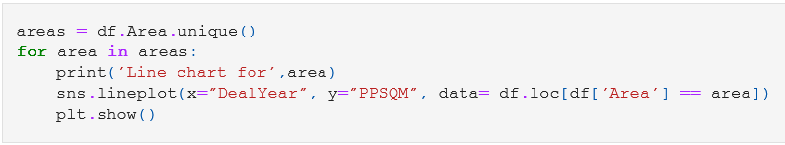
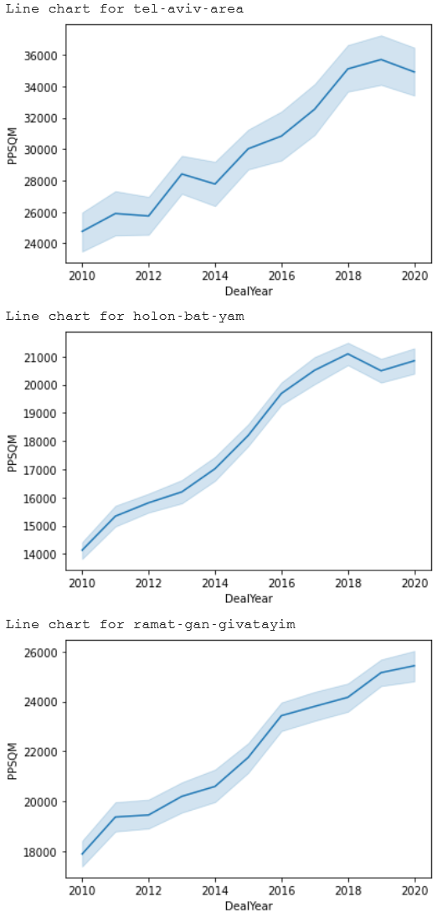
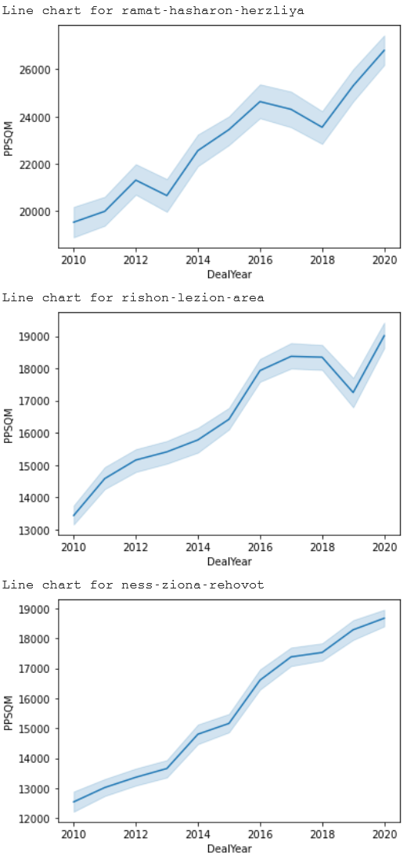
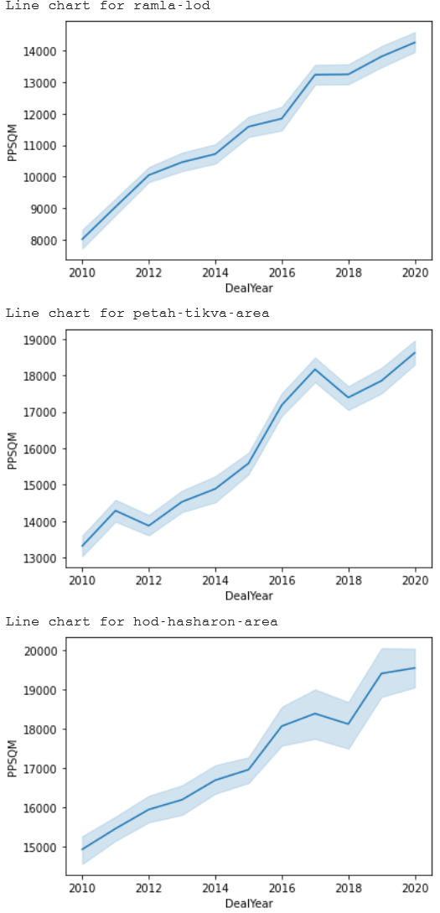
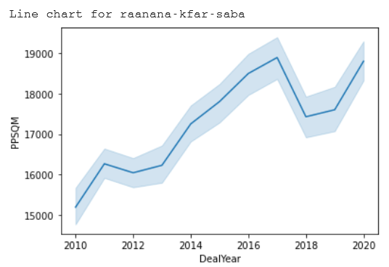
Visualization of price per square meter (PPSQM) over the years: Graphs

Slide 12
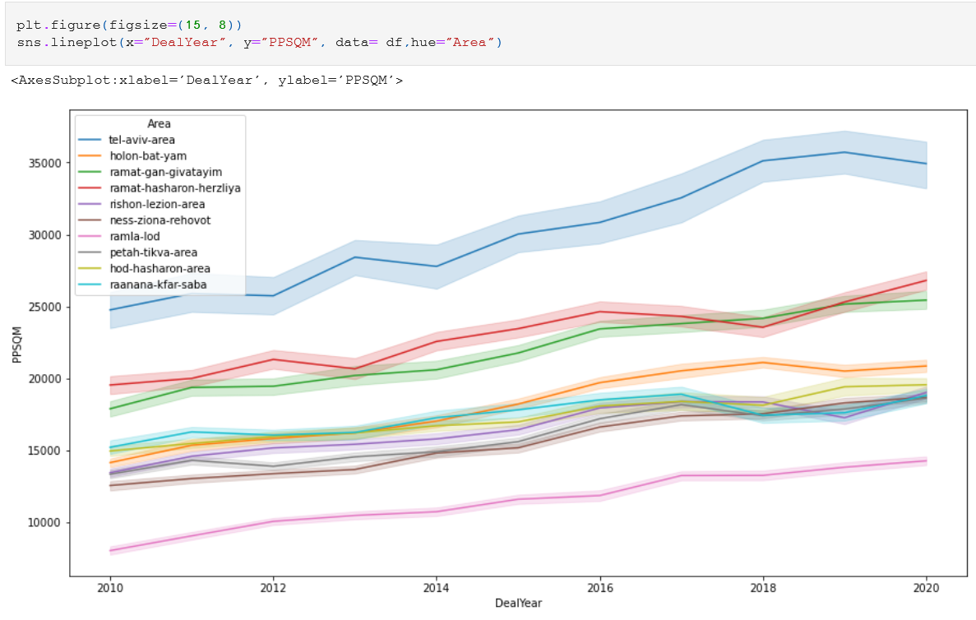
Visualization of house pricing increase in Gush Dan by areas:

Slide 13
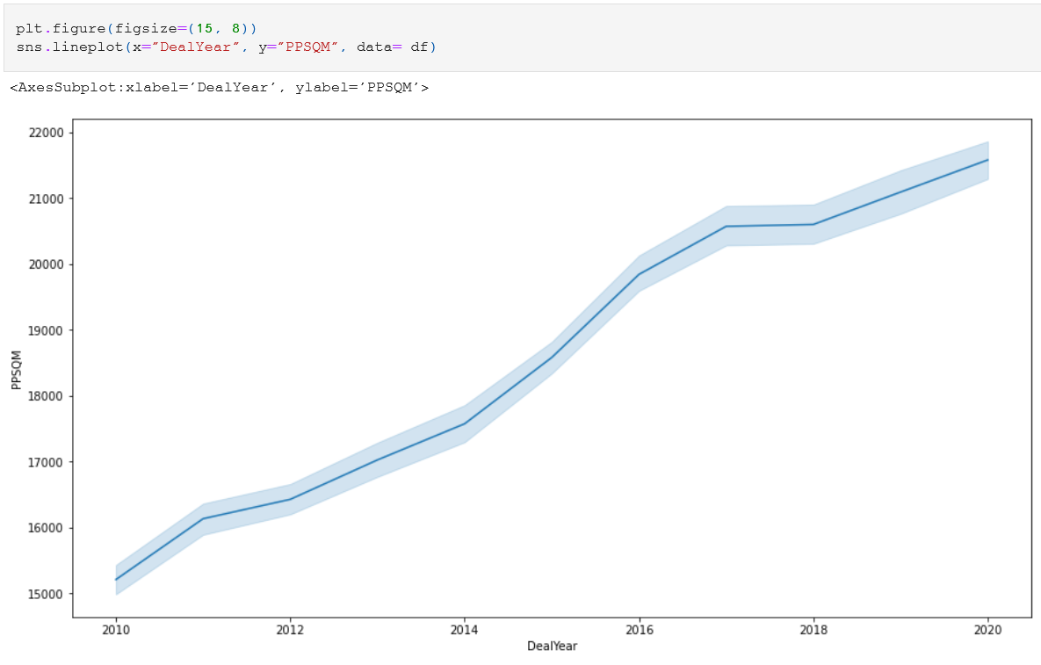
Visualization of house pricing increase in Gush Dan collectively: Graphs

Slide 14
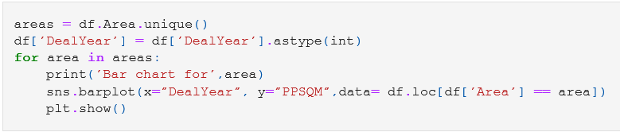
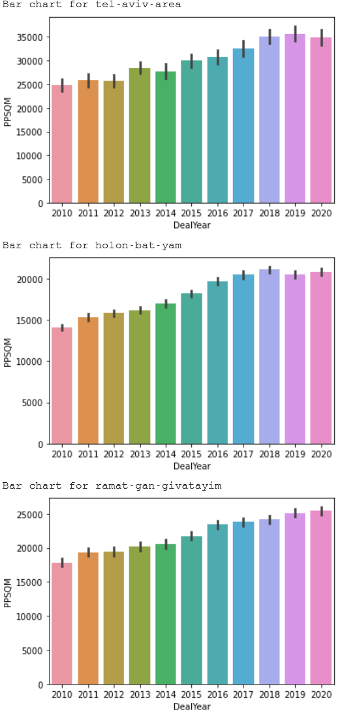
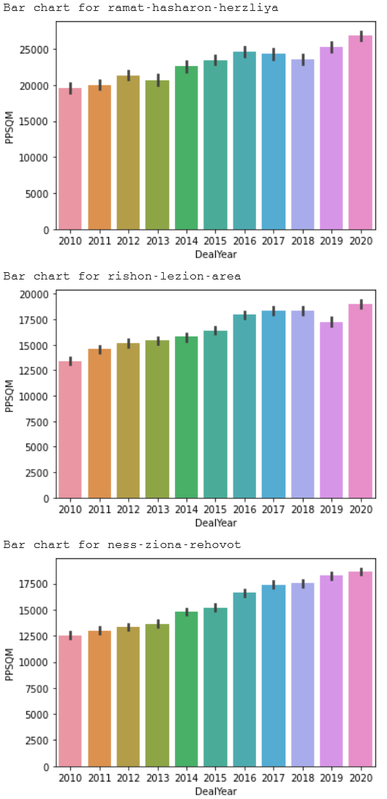
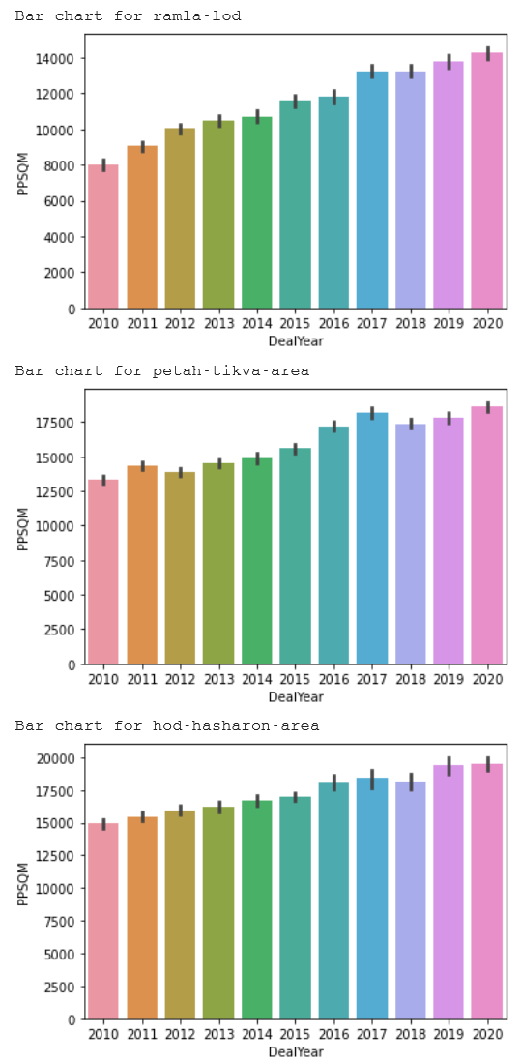
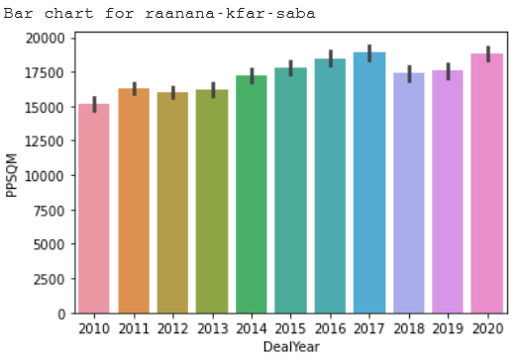
Visualization of house pricing increase in Gush Dan divided by cities: Bar Charts

Slide 15
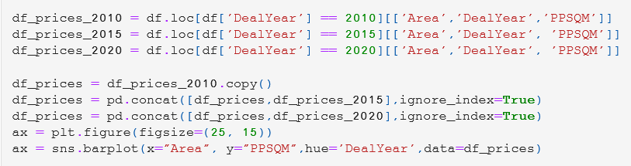
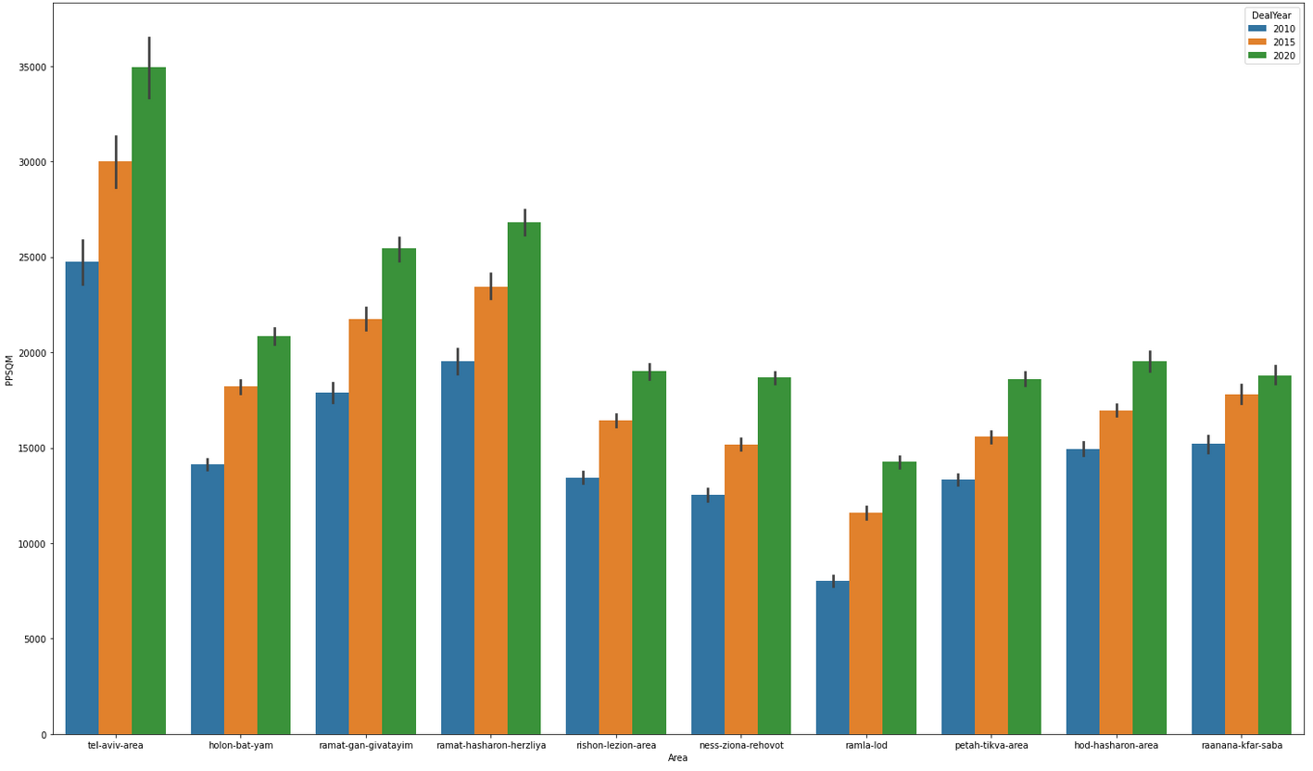
Visualization of house pricing increase in Gush Dan collectively: Bar Chart

Slide 16
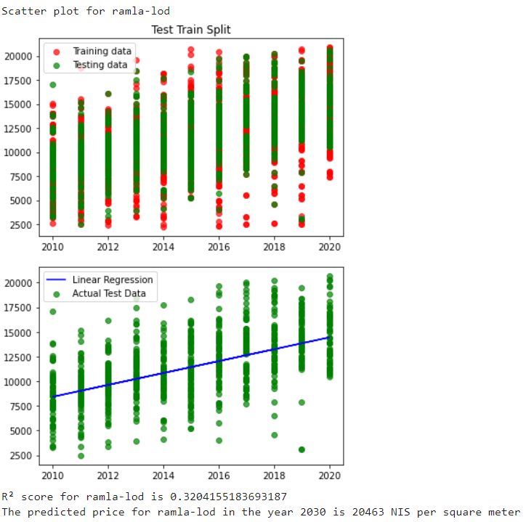
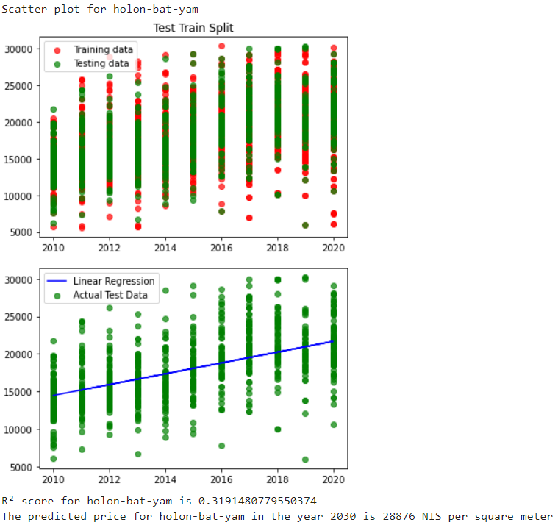
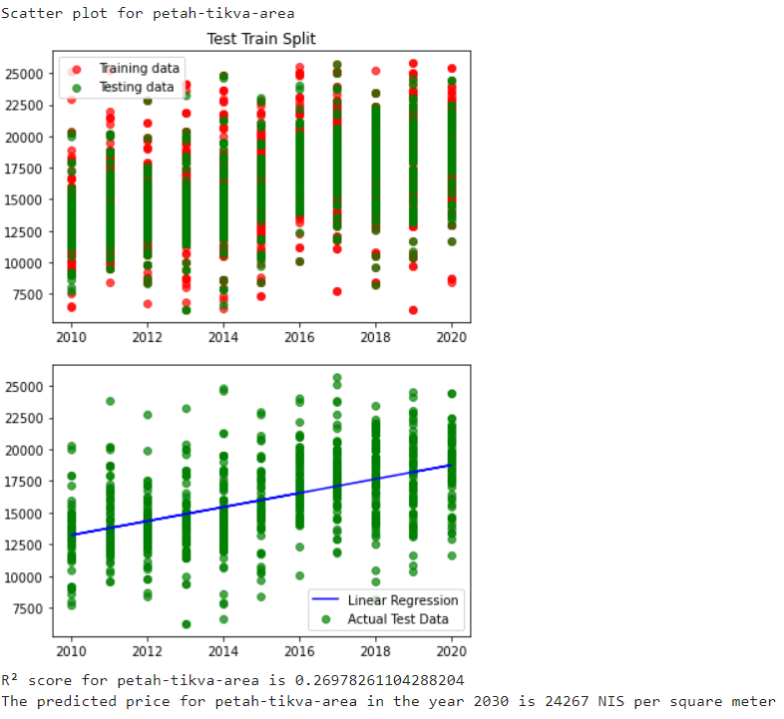
Machine Learning: Linear Regression
We chose ‘Linear Regression’ as the machine learning module to predict future prices rise in Gush Dan

Slide 17
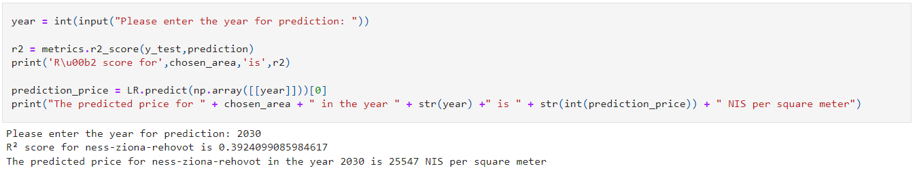
Predicting the price rise

